Slide 1
Computer Graphics and Image Processing
OpenGL

Slide 2
Outline
OpenGL and associated Libraries
OpenGL Primitives
A Simple OpenGL Program

Slide 3

OpenGL
Graphics rendering API
Allows graphics to be OS independent and window system independent
Other APIs:
Direct3D (graphics part of DirectX),
Metal (iOS API)
Vulcan (new, very low level API)
Other Versions:
OpenGL ES (smartphones, tablets, etc)
WebGL (web browsers)

Slide 4
GL/GLU/GLUT
We use three OpenGL components:
GL, GLU, GLUT
GL is the main library
GLU is the OpenGL Utility library
Projections
GLUT OpenGL Utility Toolkit
Create windows
Handle input
Create simple objects to draw
Note: GLU & GLUT are only used with legacy OpenGL
Application Program
GLUT
GLU
GL
Hardware-specific drivers

Slide 5
Defining Vertices
In OpenGL we deal with Vertex position data
We use functions to place them
glVertex2f(x, y); //2D, floats
glVertex3d(x, y, z); //3D, doubles
glVertex3i(x, y, z); //3D, integers
glVertex2fv(vals); //2D, float[]
For example:
//Vertex at coordinates (2, 4, -2)
glVertex3f(2.0f, 4.0f, -2.0f);

Slide 6
Primitives
OpenGL supports 10 ways to assemble vertices into primitives
GL_POINTS GL_TRIANGLE_STRIP
GL_LINES GL_TRIANGLE_FAN
GL_LINE_STRIP GL_QUADS
GL_LINE_LOOP GL_QUAD_STRIP
GL_TRIANGLES GL_POLYGON
glBegin(GL_TRIANGLES);
glVertex3f(x, y, z);
… //Specify more vertices here
glEnd();
Details/examples for each of these is on Canvas/Files/OpenGL/CS373-OpenGL-Reference.pptx

Slide 7
GL_POINTS
Lets assume we have an array, vertices[] of 2d vectors
Every vertex is a single point
glBegin(GL_POINTS);
glVertex2fv(vertices[0]);
glVertex2fv(vertices[1]);
glVertex2fv(vertices[2]);
glVertex2fv(vertices[3]);
glVertex2fv(vertices[4]);
glVertex2fv(vertices[5]);
glEnd();
glBegin(GL_POINTS);
glVertex2fv(vertices[2]);
glVertex2fv(vertices[1]);
glVertex2fv(vertices[0]);
glVertex2fv(vertices[5]);
glVertex2fv(vertices[4]);
glVertex2fv(vertices[3]);
glEnd();

Slide 8
GL_LINES
Each pair of vertices is an independent line segment
To connect line ends we have to repeat vertices
glBegin(GL_LINES);
glVertex2fv(vertices[0]);
glVertex2fv(vertices[1]);
glVertex2fv(vertices[2]);
glVertex2fv(vertices[3]);
glVertex2fv(vertices[4]);
glVertex2fv(vertices[5]);
glEnd();
glBegin(GL_LINES);
glVertex2fv(vertices[3]);
glVertex2fv(vertices[0]);
glVertex2fv(vertices[4]);
glVertex2fv(vertices[1]);
glVertex2fv(vertices[5]);
glVertex2fv(vertices[2]);
glEnd();

Slide 9
GL_TRIANGLES
Every 3 vertices is an independent triangle
Triangle n is defined by vertices (3n, 3n+1, 3n+2)
glBegin(GL_TRIANGLES);
glVertex2fv(vertices[0]);
glVertex2fv(vertices[1]);
glVertex2fv(vertices[2]);
glVertex2fv(vertices[5]);
glVertex2fv(vertices[3]);
glVertex2fv(vertices[4]);
glEnd();
glBegin(GL_TRIANGLES);
glVertex2fv(vertices[0]);
glVertex2fv(vertices[2]);
glVertex2fv(vertices[1]);
glVertex2fv(vertices[5]);
glVertex2fv(vertices[4]);
glVertex2fv(vertices[3]);
glEnd();
NOTE: Vertices defined in anti-clockwise order
NOTE: Vertices defined in clockwise order

Slide 10

State-Based Operations
Many OpenGL commands set rendering state
The new state applies to all things rendered from that point forward
This can even apply halfway through a primitive
Notes:
This can cause some interesting behaviour in an application like a game where you render many frames – state changes halfway through one frame will still apply at the start of the next frame.

Slide 11
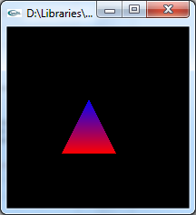
Example: Adding Colour
We specify colour in a similar way to vertices
glColor3f(r, g, b);
Once we set a colour, it applies to all vertices from then on
glBegin(GL_TRIANGLES);
glColor3f(1.0f, 0.0f, 0.0f);
glVertex2f(3.0f, 3.0f);
glVertex2f(6.0f, 3.0f);
glColor3f(0.0f, 0.0f, 1.0f);
glVertex2f(4.5f, 6.0f);
glEnd();

Slide 12
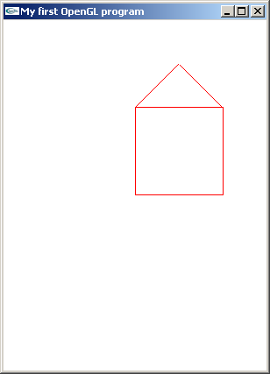
Putting it together
We define a simple house shape in wireframe
We draw in 2D
y
x
The Situation
The Program Output

Slide 13
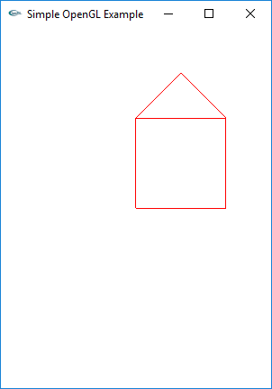
Putting it together
5 steps for our simple program (order varies):
Create a window
Initialize the program (e.g. projection)
Define the scene
Define rendering parameters
Draw
Source code is on
Canvas/Files/OpenGL

Slide 14
Graphics Program Structure
The program could be structured like this:
Define Scene // Variables storing mesh info, or function loading from file
CreateWindow() // open a window into the frame buffer into which the
// program will draw.
// A GL context is associated with the window and all
// subsequent OpenGL commands are with respect to // the current context.
InitialiseProgram() // Specify how scene (2D or 3D) is mapped onto a // window on the screen
DefineRenderingParameters() // For example, lighting
Draw() // Set colour or material properties of objects & draw them

Slide 15
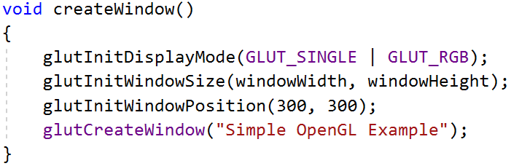
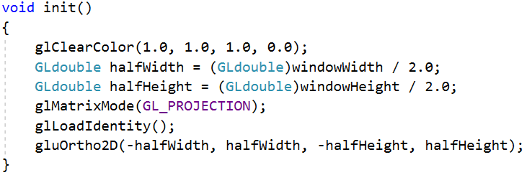
1. Create Window, 2. Initialize

Slide 16
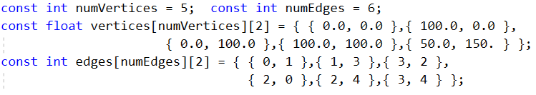
3. Define Scene/Mesh
Vertices are a pair of floats giving (x, y) cords
Our primitive is GL_LINES, so our indices defines pairs of vertices corresponding to lines
Lines share vertices

Slide 17
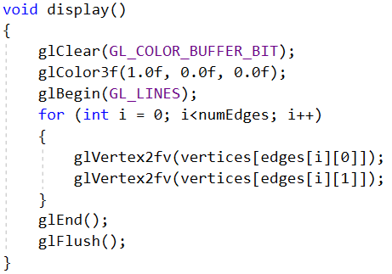
4. Rendering Parameters, 5. Draw
Our program is too simple to need step 4

Slide 18
Quiz
How do we draw the house in white
on a black background?
How can we draw the house at
the bottom left of the window?
Hint: 3 different answers to this question

Slide 19
Quiz
How do we draw the house in white
on a black background?
How can we draw the house at
the bottom left of the window?
Hint: 3 different answers to this question
void display(void){ … glColor3f(1.0, 1.0, 1.0); // white …. }
void init(void) { … glClearColor(0.0, 0.0, 0.0, 0.0); // black … }

Slide 20
Quiz
How do we draw the house in white
on a black background?
How can we draw the house at
the bottom left of the window?
By modifying the vertices
By modifying the projection matrix
(Changing the gluOrtho2D() arguments)
By applying a translation
void display(void){ … glColor3f(1.0, 1.0, 1.0); // white …. }
void init(void) { … glClearColor(0.0, 0.0, 0.0, 0.0); // black … }

